Slide 1
Phase 1 – flow diagram and app screens
1.Mine ------------------ 2.transporter ---------- 3.buyer -------- ------ us
1.1Dashboard 2.1 dashboard 3.1dashboard 4 control panel
1.2 Control 2.2 driver
1.3 Security
1. Buyer or transporter or mine or us can upload spreadsheets / truck list
2. Driver heads to mine/ loading point (trip status = otw to loading point)
3. Truck arrives at mine (security search truck) (marks arrived)
4. Truck loads – control enters tons loaded – truck is marked as loaded
5. Truck leaves (security marks as left) (trip status = loaded otw to delivery)
6. Truck offloads at delivery (driver uploads POD) (trip status = delivered)
7. System updates recons (then process starts again)
Notes:
This is how the operation will flow in phase 1. so we need to make the user experience as simple as possible especially for the mine control security and the driver app. I'm going to dive deeper into how the screens should look, this is not in stone, but a guideline. The important thing is giving the user a very friendly and easy system to use that will make their lives easier! No complicated and long steps.

Slide 2
MG
Create profile
1.Organisation >
1.mine/ supplier
2,buyer
3,Transporter
Moving effective and efficiently
2.Role >
1,1-security
,2- control/WB
,3- admin
,4- management
2.1 admin
2,2. management
Username:
Password :
3.1 driver
3,2 admin
3,3 management
3. Name, surname, ID
4. Contact
Phone no.
Whatsapp
Email
*Anyone of these should be login username
Create profile
5. Password>
Password
Confirm password
Notes:
Upon opening the app this is how it should be, I saw you already have this, well done!!! So important thing here is like you mentioned is that not anyone can just download the app and create a profile and use the system. So how it works is – mine / buyer / transporter enrols with us. We set up their organisation , its like we create their profiles on our side giving them access to the platform – once they have access , their admin person can add the securities , control/weighbridge, and drivers. Using email or WhatsApp or phone numbers. I'm going to put this in the dashboard so you will see what I mean if you don’t understand.

Slide 3
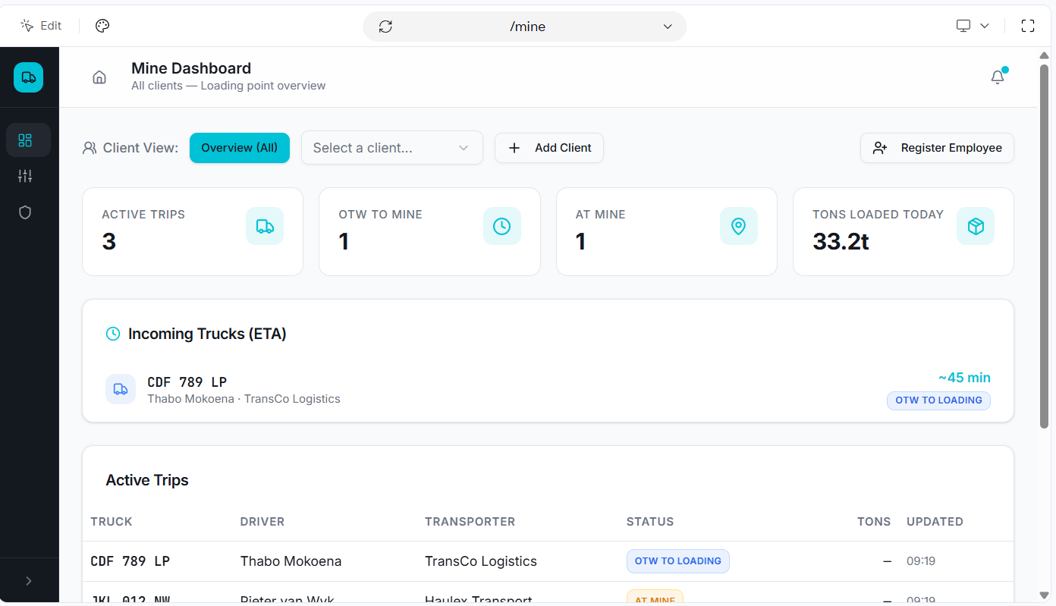
client
Truck reg
Eli
12nv34 gp
Notes:
Here is the mine dashboard – important checklist [ can register employee under control or security. – can track\locate trucks, see estimated eta(when you click on incoming trucks),- Can view individual clients\buyers data.

Slide 4
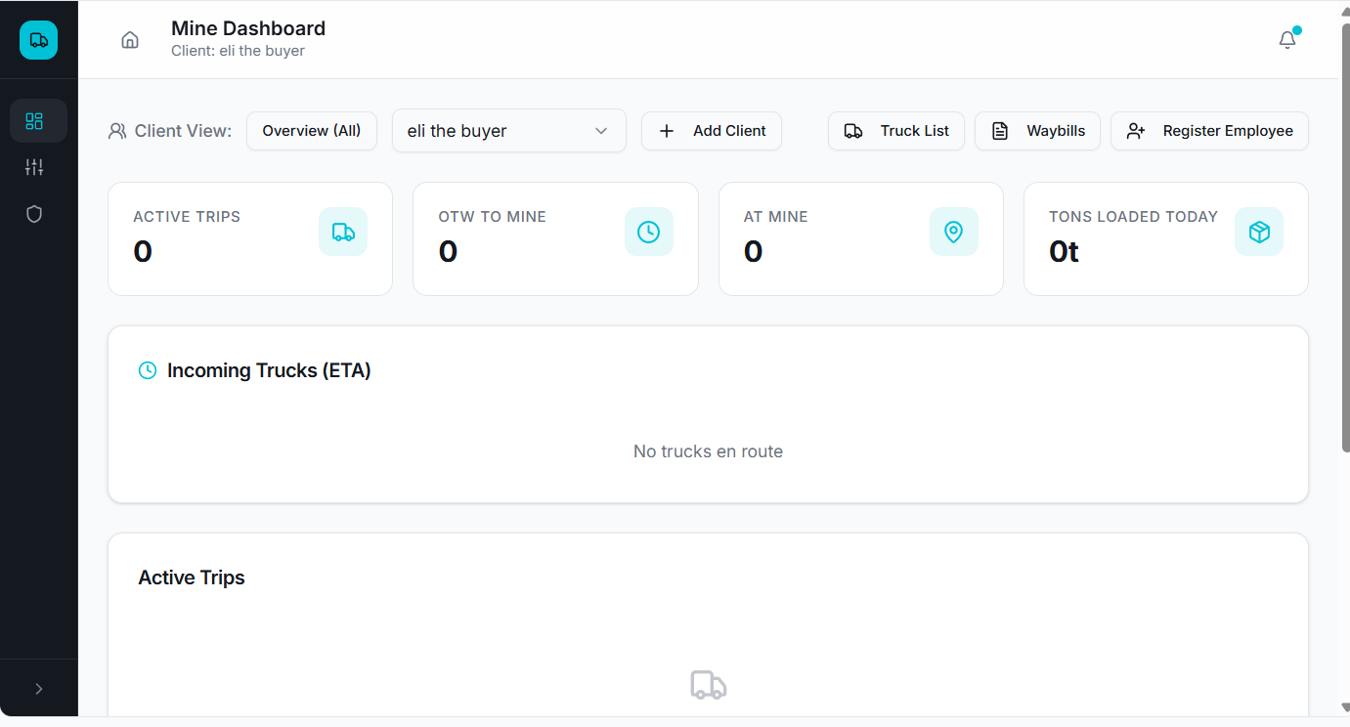







Download recon excel spreadsheet
Tons
Day=
Week=
Month=
Year=
Notes:
Once we click on a client – important checklist – same as previous but for individual client- additional buttons= [truck list – to add or edit for client or transporter.] [ waybills – to enter waybill details for current client ] [download excel spreadsheet for full recons ]

Slide 5
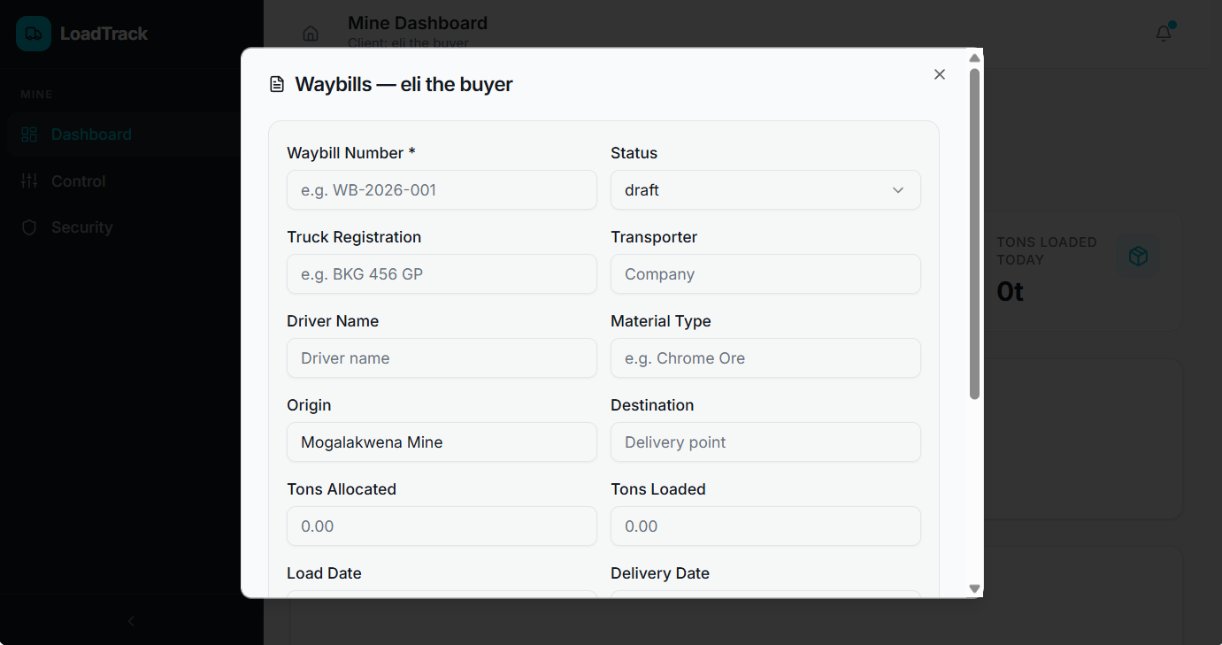



Order number
+ trailers
Product
Time
Seal numbers
Notes:
This is what the waybill should have. Mine should be able to edit these details- however the buyer is the main one who will enter waybill details. Because different transporters can offload at diff points , diff offloading points can have diff order number.

Slide 6
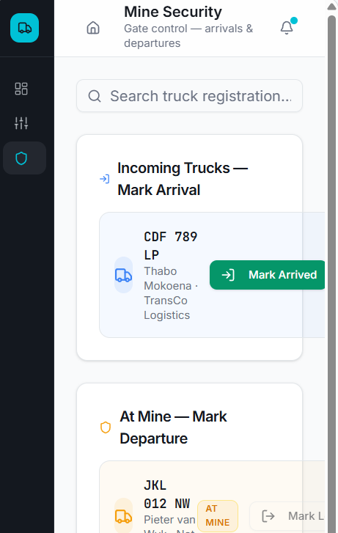



Dv12uh GP
client name
Trans name
Driver name
Notes:
For mine security, very simple , security at gate just needs to search for truck then mark arrived(time stamp for detailed recons), when truck is done loading and is leaving he ticks ‘truck departed’

Slide 7
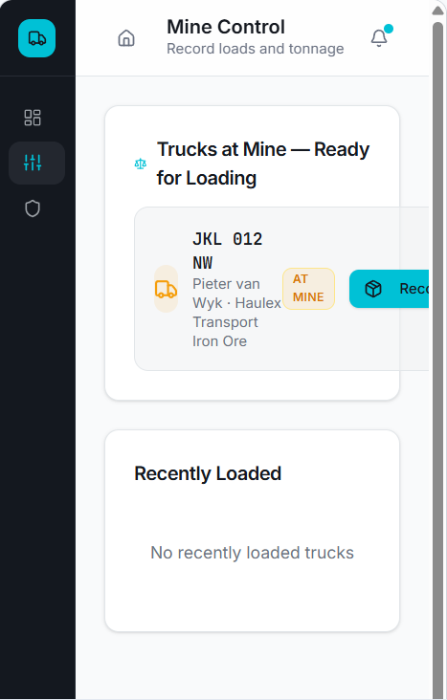
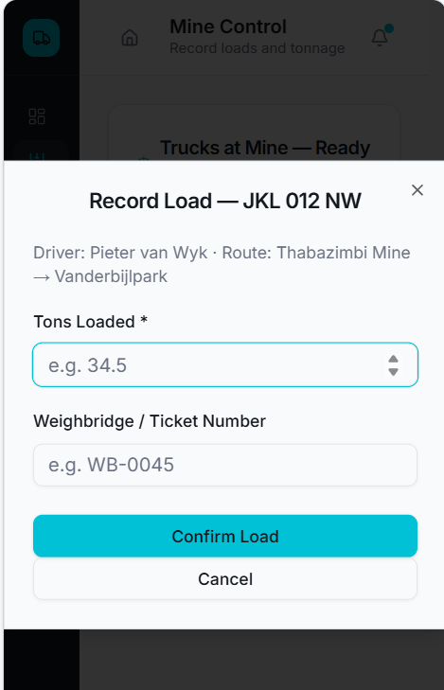


Search truck
Dv12uh GP
client name
Trans name
Driver name
Check eta and location of trucks OTW to mine
Notes:
For mine control/weighbridge – need to be able to [ search trucks – enter tons for loaded truck – search for trucks otw to mine, see the eta and location]

Slide 8
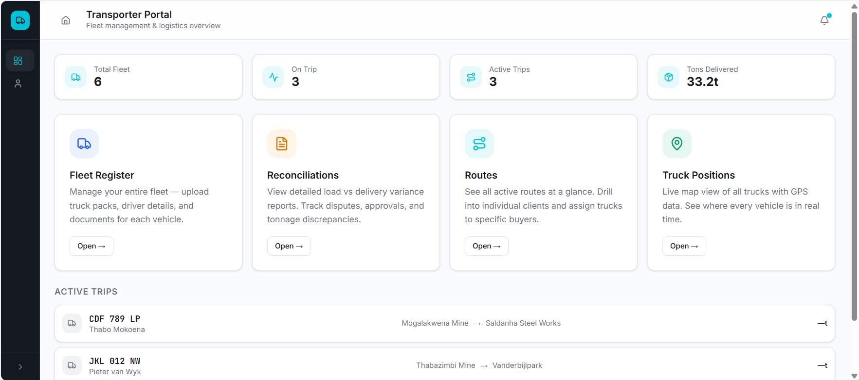
Notes:
This is what we need for the main transporter portal. At tons also it needs to be – day, week, month , year.

Slide 9
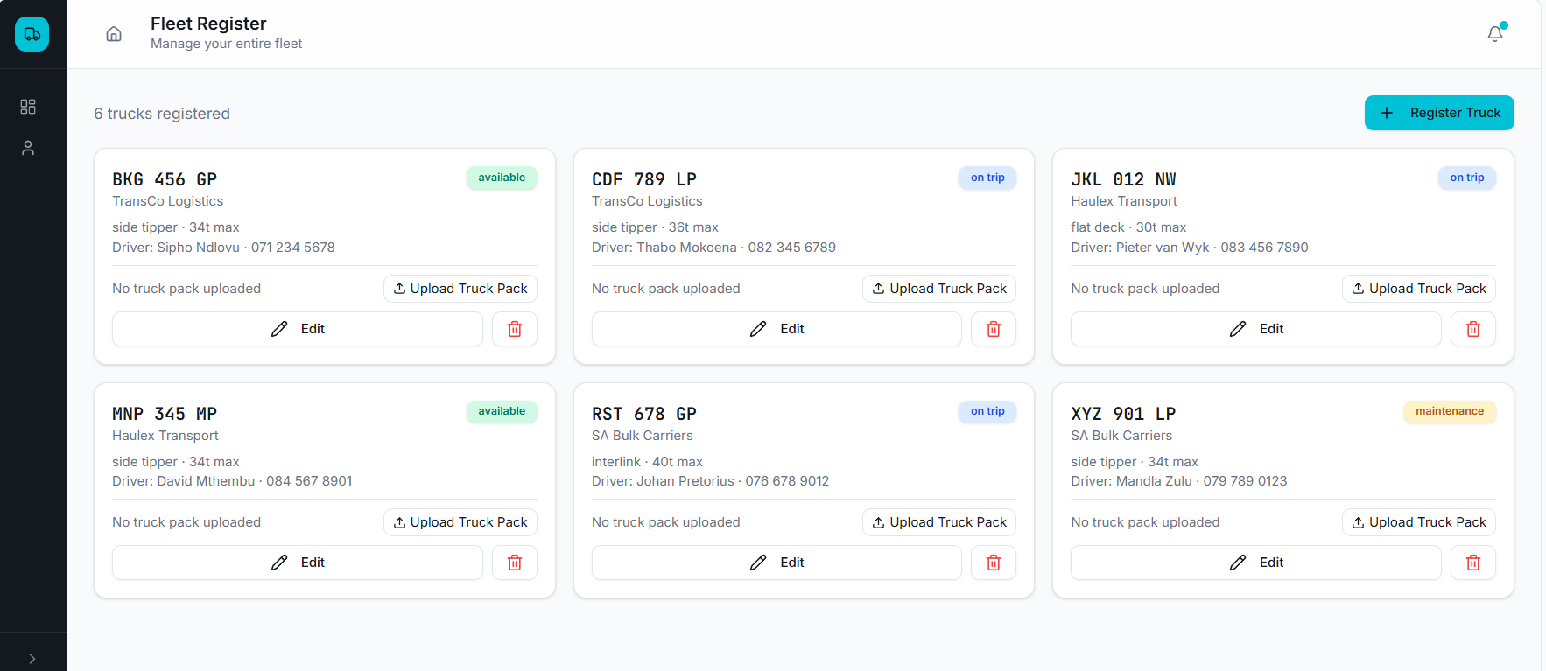
Notes:
This is where trans will upload fleet register and truck packs, should have a list view and search button.

Slide 10
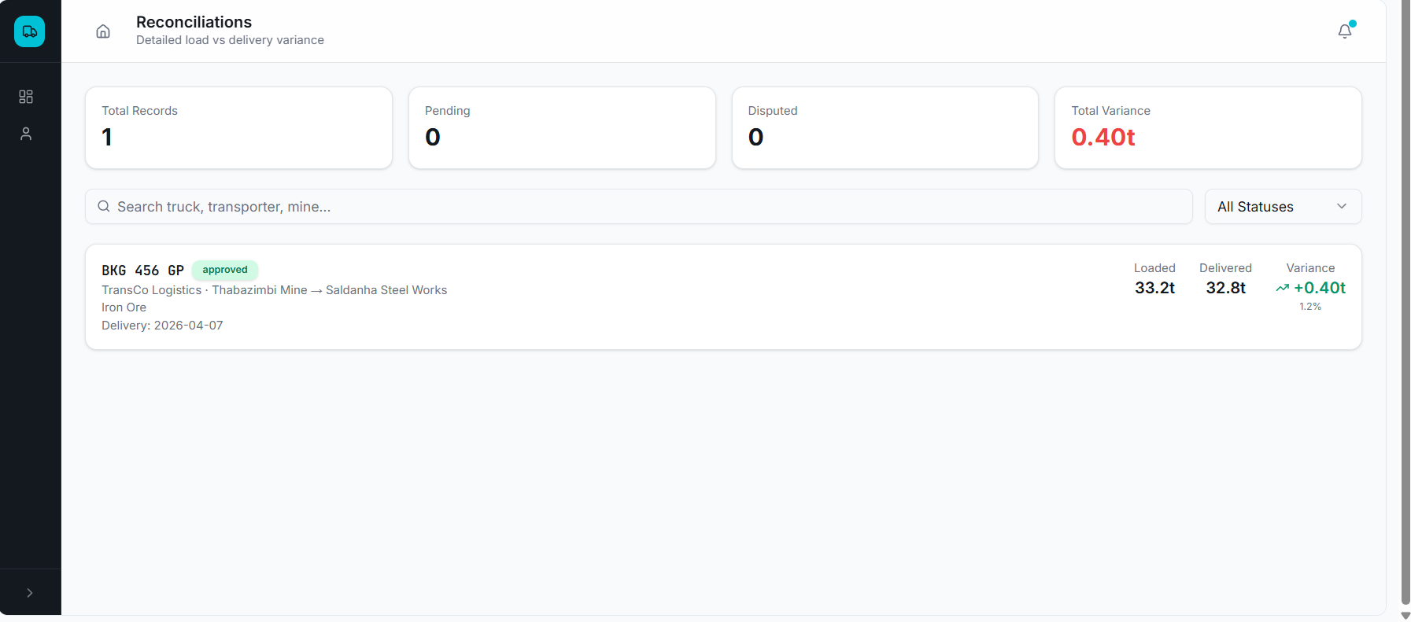
Notes:
For recons , also should be able to filter for individual routes/ buyers to generate a excel or pdf format. Should have a option to generate a invoice ( for the trans to send an invoice to their client, with attached route data )

Slide 11
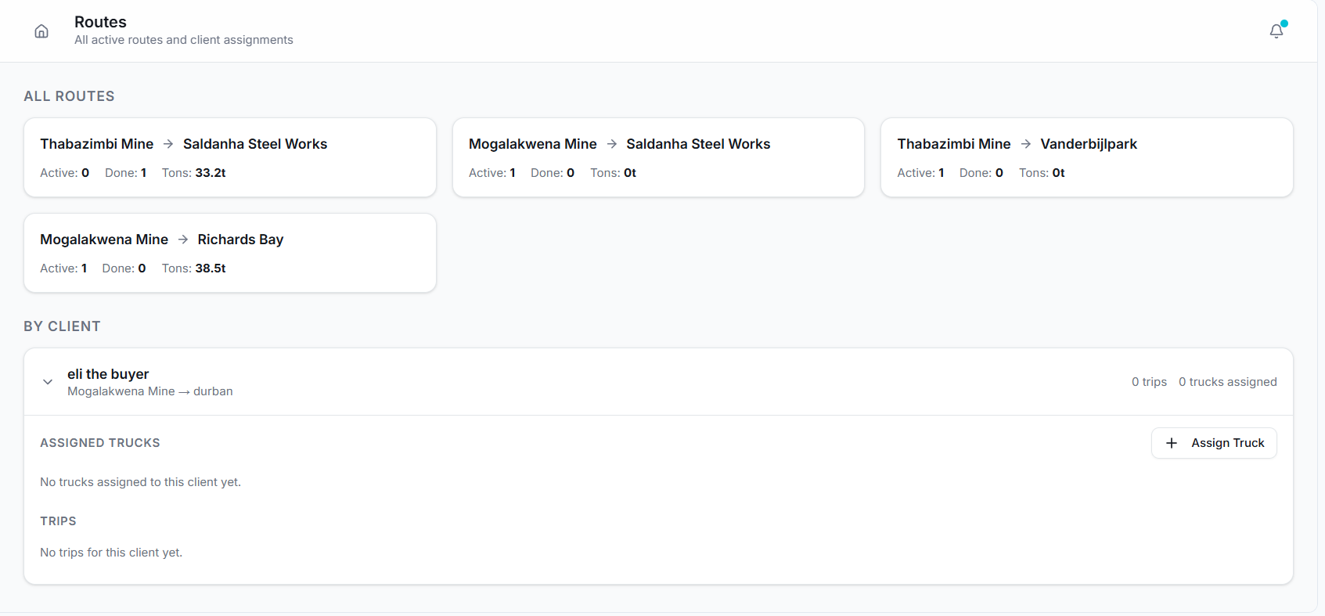
Notes:
Trans can see all routes , here they can assign trucks to specific routes/ clients. When they click on a route they will see past trips and trucks otw to loading or offloading

Slide 12
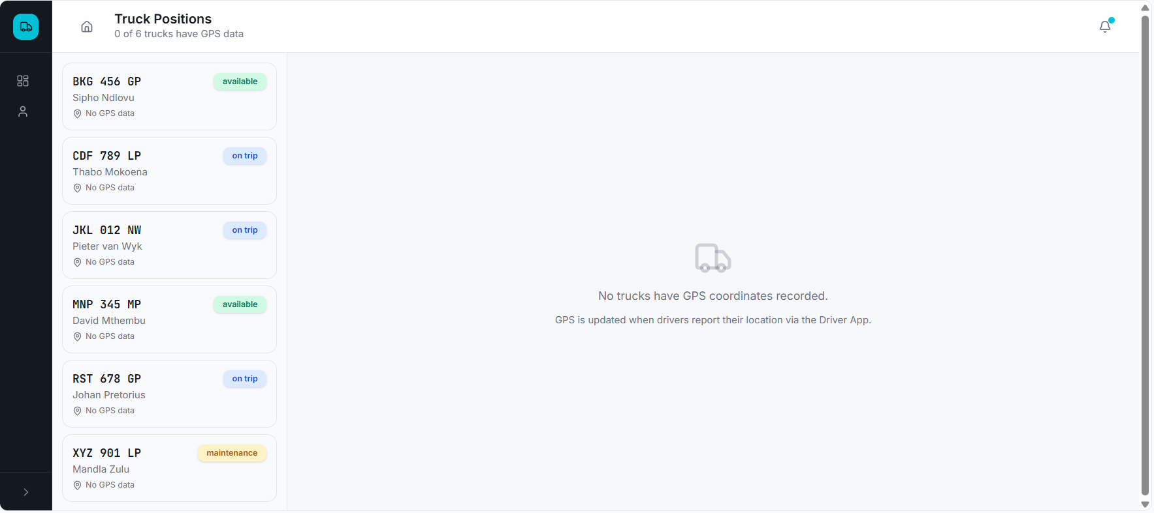
Notes:
Display a map with live positions of trucks

Slide 13
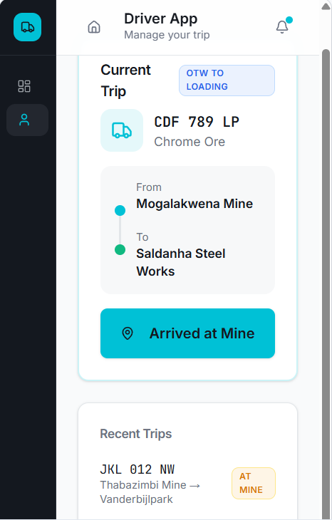























Directions
Arrived at loading
Arrived at offloading
Upload POD
Notes:
Driver app also very simple interface. When he opens app it needs to force location to turn on, if its off. He needs to see the trip he is assigned to, a button to give him directions on a map to loading point and offloading point. Then a tick box for arrived at mine , arrived at loading then a tab to upload POD ( so sometimes at offloading they also weigh the product , in that case in the tab for upload POD there needs to be a space where he can fill in tons offloaded. At the bottom he can see recent trips and then also needs to see future/ planned trips

Slide 14
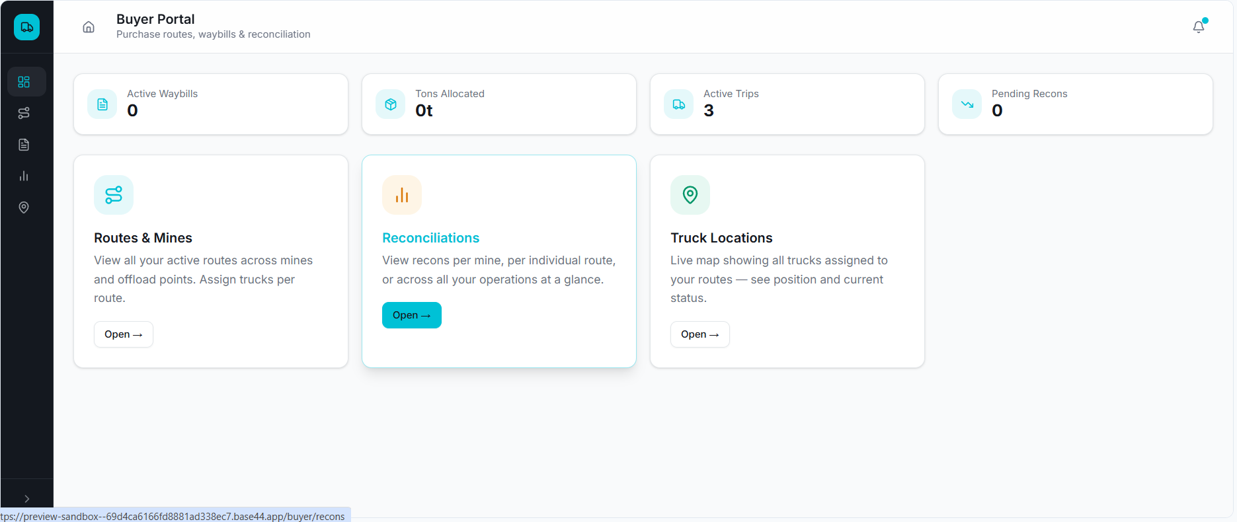
Notes:
Buyer portal something like this

Slide 15
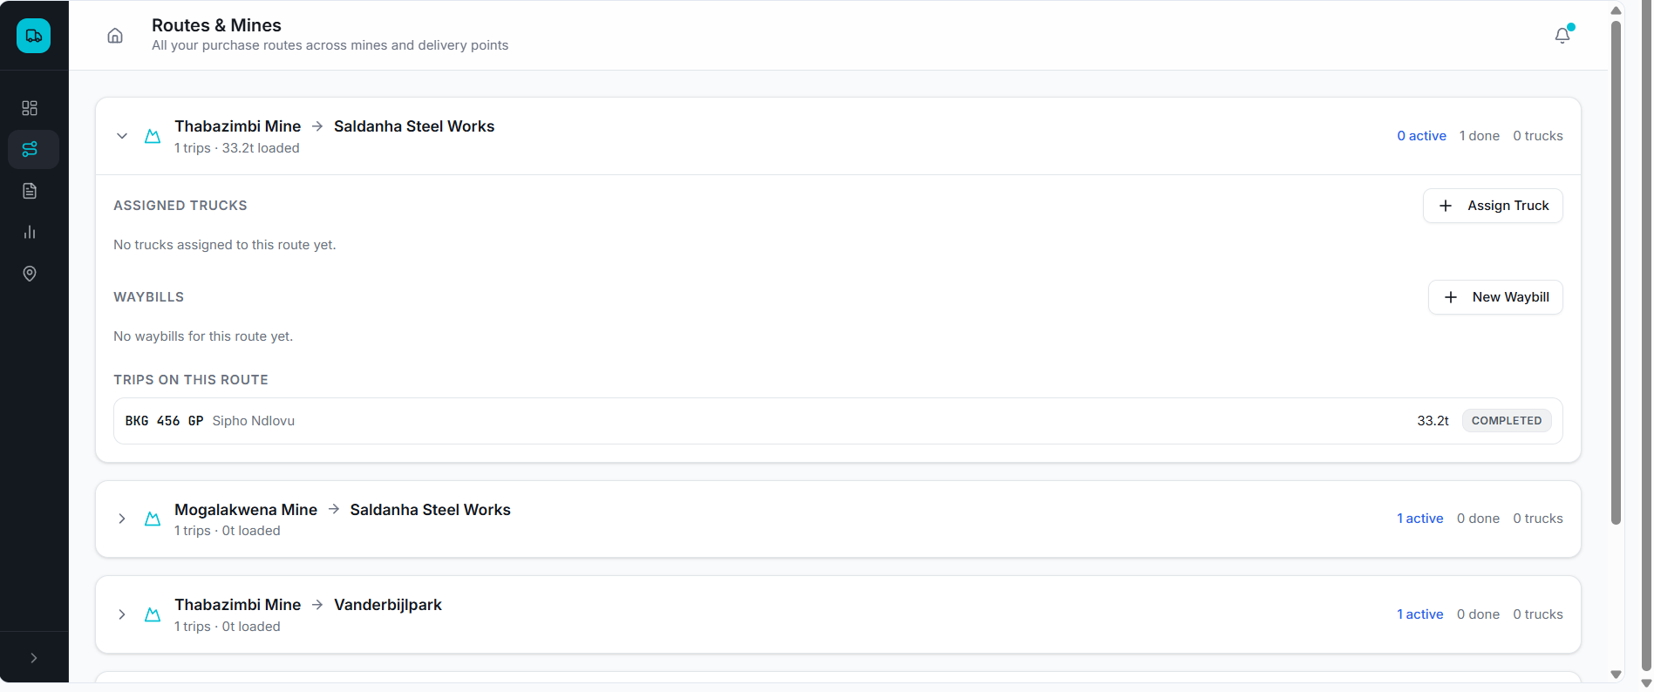
Notes:
When you click on routes and mines buyer will see what he is currently moving. He can assign trucks to that route, then manage the waybill ( this waybill info will then sync with mine waybill- all mine does (control) is enter the tons.

Slide 16
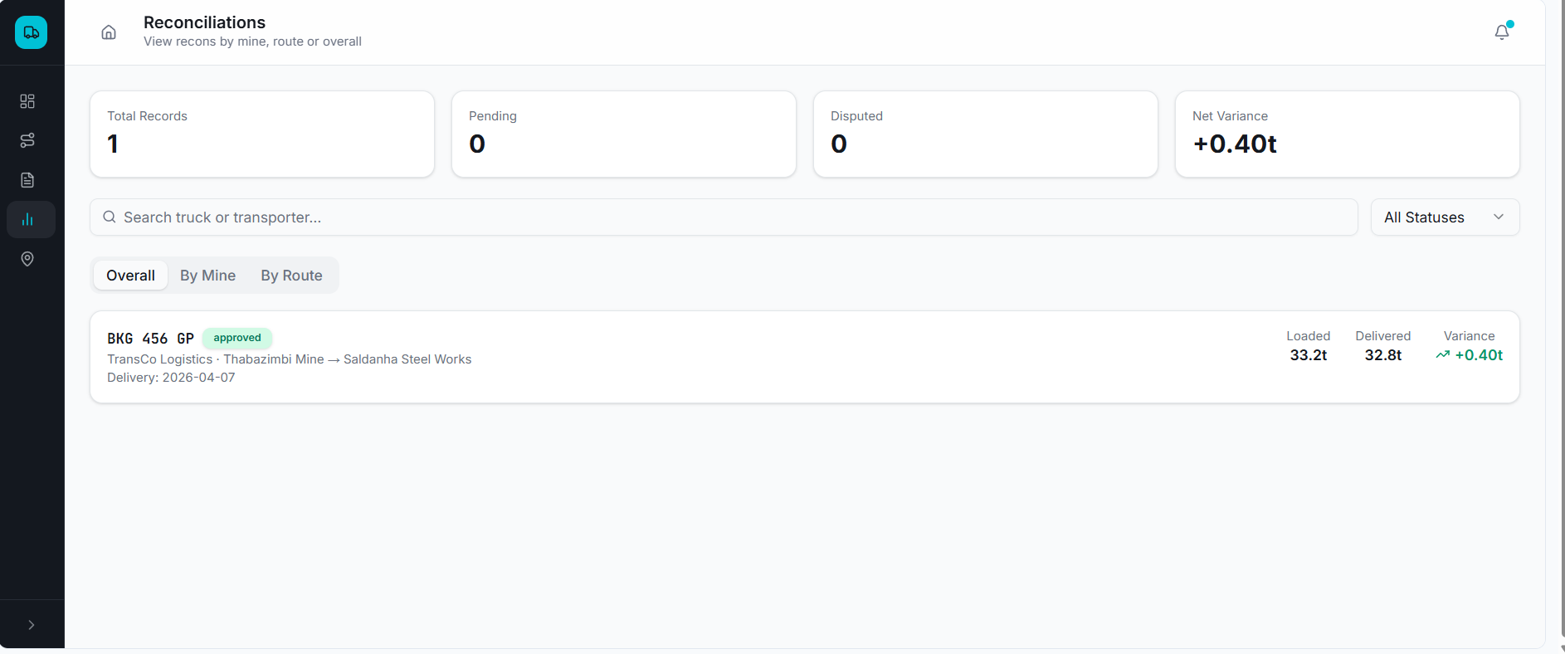
By transporter
Notes:
Buyer can view recons , filtered by mine , route or transporter. Like transporter, buyer needs to be able to download excel or pdf format each filter option.

Slide 17
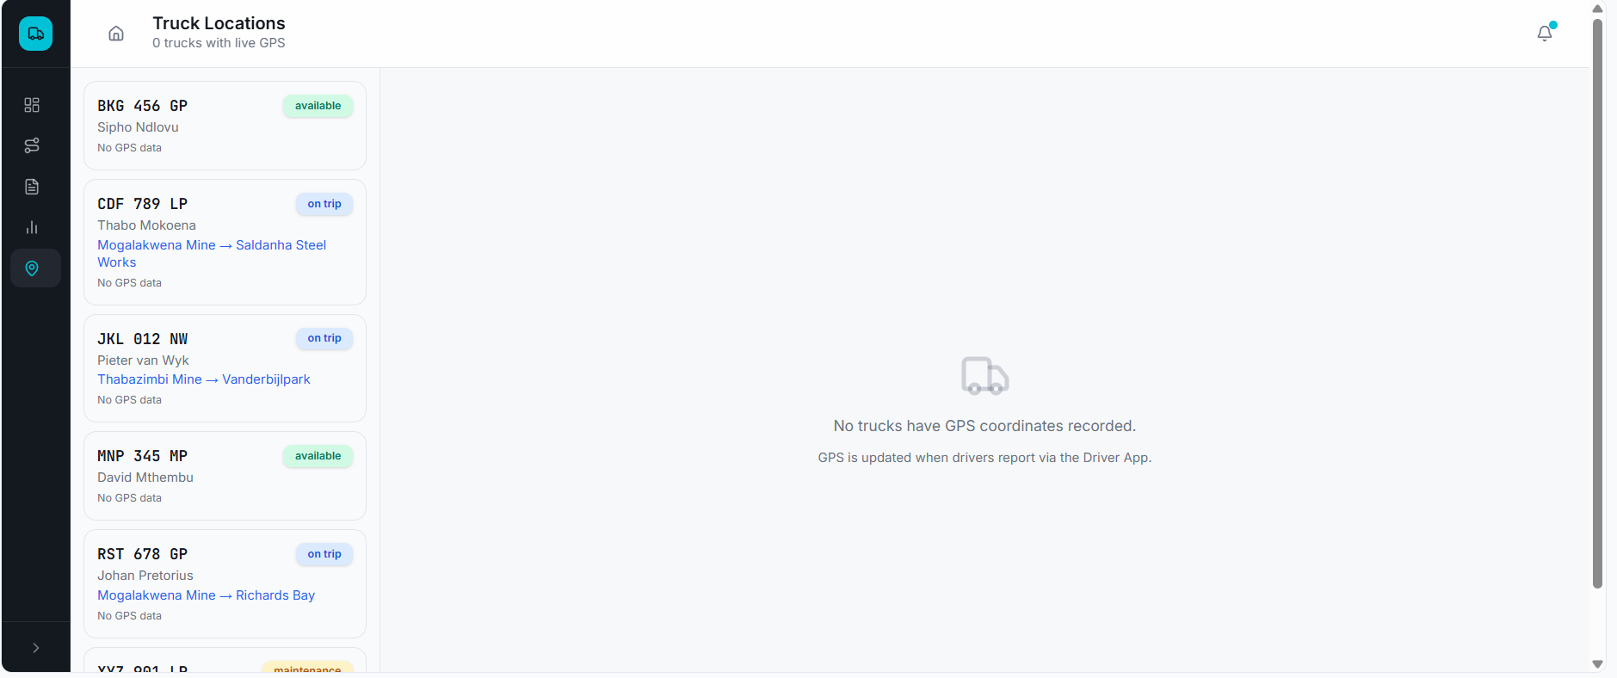
Notes:
View locations of trucks assigned to buyer by transporter, buyer can see eta of trucks approaching loading or offloading.

Slide 18
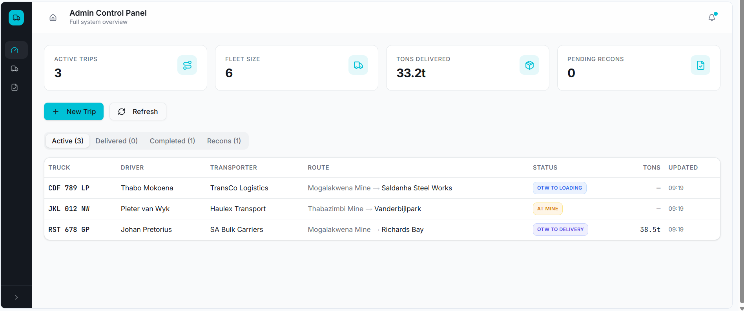
Notes:
This is our admin panel, here we will be able to have oversight for everything mine trans buyer. We use this to generate invoices for our clients

Slide 19
Security screens
After he searches and truck is on list this is the next screan
MG
This has to time stamp on recons – time arrived on site
kpx154mp approved
Search
Truck on site
y
n
options
*To report if a truck isn’t on the list. Or once the guard search and it doesn’t find a truck it should automatically give a prompt to report truck not on list
Truck then goes into mine to load the commodity – when it comes back out the a guard will inspect it again ( it has already been time stamped in so now he is searching to time stamp out)
Kpx154mp
Truck loaded
Truck sealed
Truck gone
For time stamps
y
n
y
n
y
n

Slide 20
Control screens
This is the 1st screen where control can search for truck
Once control searches truck, the info from spreadsheet will auto fill here: she will just have to manually type in total tons as well seal numbers
Search
Kpx154mp
Transporter :
Destination :
Product:
Order no :
Despatched by :
Time in:
1st weigh :
2nd weigh :
Total tons :
Driver :
Seal1 :
Seal 2 :
Seal 3:
Seal 4:
Options
To attach or take pictures of seals if necessary
attach
For time stamp on recons
Options to report any problems
Truck left
y
Options

Slide 21
Admin screens
Management
This will be a work in progress but to start should be same as admin and have all their features. A lot will be added here once we work on mining operations systems- will add cameras around the mine , he can view here, he will be able to see production reports and plan of action and more. Will have a manage options.
Mr bean
Henny coal mine
Will then be the same as control screen,
Control
admin
admin
>Upload fleetlist
>Edit fleetlist
>Check recons
>Locate truck
Control
admin
Production report
Stock levels
Clients
Cameras
Upload request
Manage

Slide 22
Buyer / client
Henny coal mine
Recons
Upload spreadsheet
sample results
Will have to go into more detail here regarding the recons and uploading spreadsheet screens, we have to figure out how that will be done
>Site / location
Might have more than one site, give him a drop down of which site he wants to view
>Overall recons

Slide 23
Transporter
Admin
>Overall recons
Transporter needs to know about his expenses
diesel consumption
Tires
Breakdowns
Stuck trucks
Route> drop down box might have multiple routes running
Once they click on eg henny coal mine
Upload spreadsheet
Edit spreadsheet
Recons
Truck locator
We will also go into more details here and more features for the transporter, he is a key player as well so we have to make his life easy as well. For now the focus is on recons

Slide 24
Recon overview
This is a general look of the recons tab. They will all be similar but eg transporter will only see whats relevant to him
Henny coal mine
Total tons moved : 5685
MTD tons: 5685
WTD tons :1351
Day tons :233
Transporter A: 1432
Transporter B: 5846
Client A: 3567/5000
Client B: 312/1000
Here they will be able to download a full pdf of whatever they want must have filter options as well, will discuss and tell you what I mean
>Download detailed spreadsheet

